Slide 1




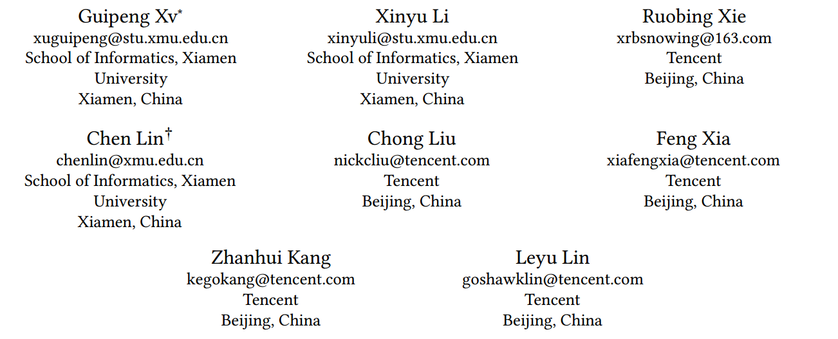





ATAI
Advanced Techniqueof Artificial Intelligence
ATAI
ChongqingUniversity _{AdvancedTechniqueof}
of Technology Artificial Intelligence
Chongqing University of
Technology
Chongqing University ^{ATAI}
_{of Technology} Advanced Techniqueof
Artificial Intelligence
Chongqing University of Technology
Chongqing University of Technology
Improving Multi-modal Recommender Systems by Denoising and
Aligning Multi-modal Content and User Feedback
code：https://github.com/XMUDM/DA-MRS
—— KDD 2024
Reported by ZhenDong Huang
1

Slide 2

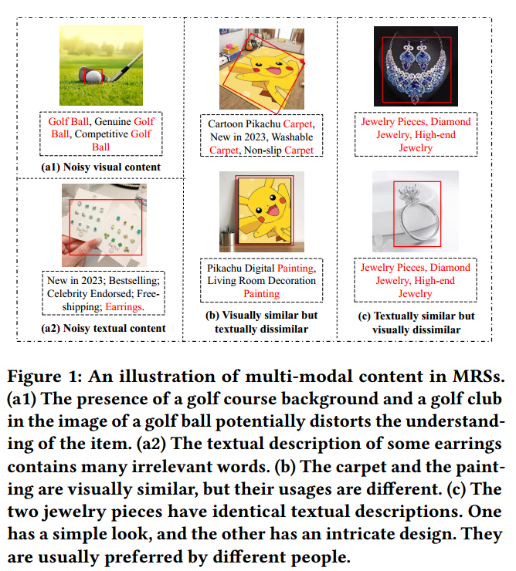
ATAI
AdvancedTechniqueof
Artificial Intelligence
ATAI
ChongqingUniversity _{AdvancedTechniqueof}
of Technology Artificial Intelligence
ChongqingUniversity of Technology
Motivation
1.Multi-modal content usually contains details irrelevant to the item.
2.Existing structure-based methods tend to ignore the noise present in multi-modal content, leading to the inclusion of false positive links that connect dissimilar items in the constructed item-item graphs
3.Although several efforts have been made to address noisy feedback data in the pure collaborative filtering setting , none is designed to utilize multi-modal content.
4.Most MRSs adopt item-level alignment, they match the multimodal content of each item by contrastive learning.However, such alignment is insufficient.

Slide 3

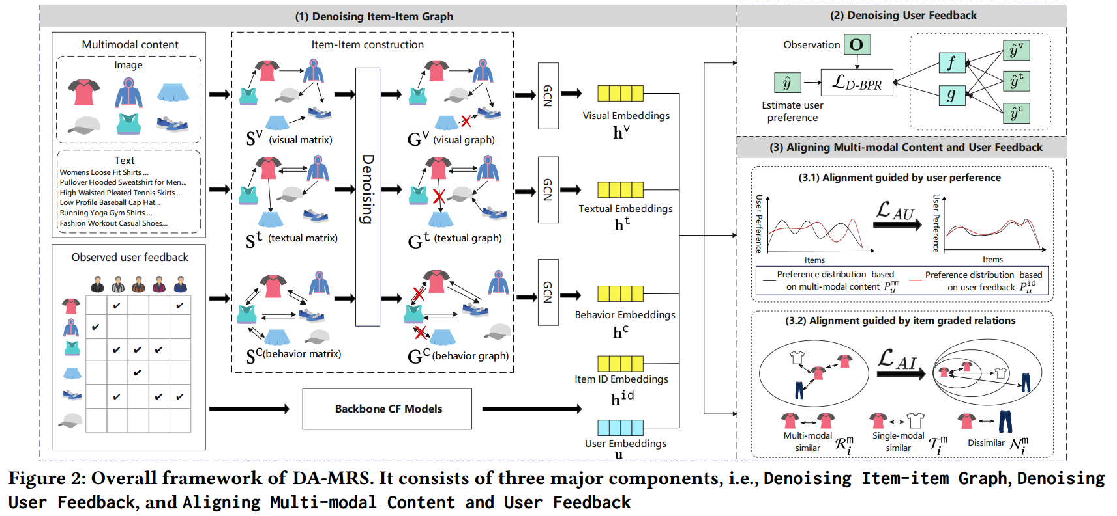
ChongqingUniversity of Technology
ATAI
AdvancedTechniqueof
Artificial Intelligence
ATAI
ChongqingUniversity _{AdvancedTechniqueof}
of Technology Artificial Intelligence
Overview

Slide 4

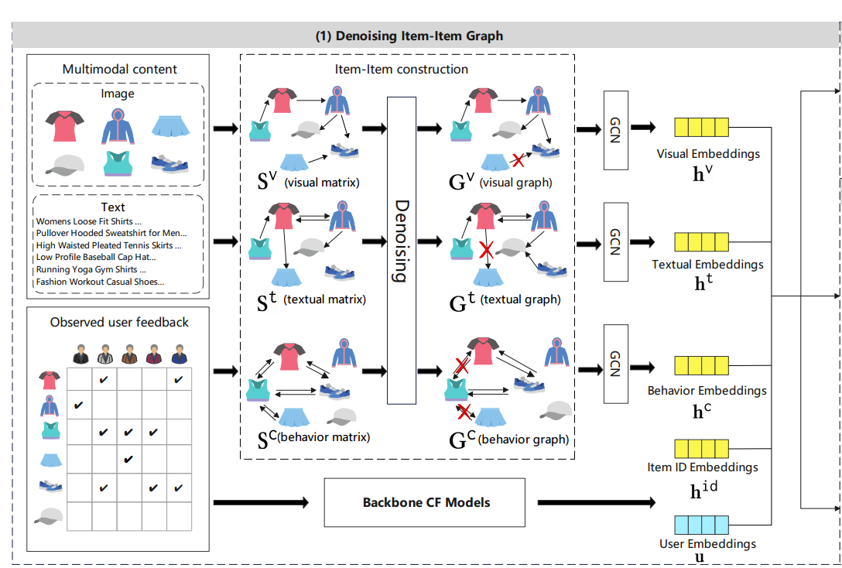

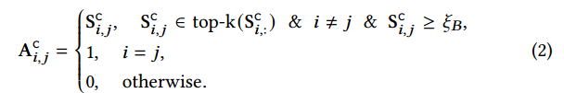

ChongqingUniversity of Technology
ATAI
AdvancedTechniqueof
Artificial Intelligence
ATAI
ChongqingUniversity _{AdvancedTechniqueof}
of Technology Artificial Intelligence
Method

Slide 5

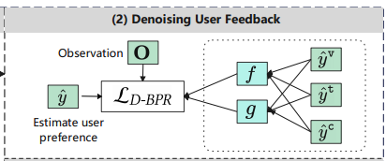
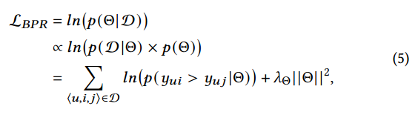
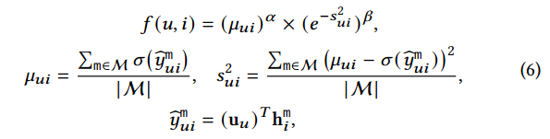
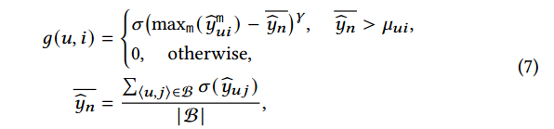
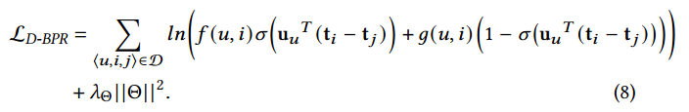
ChongqingUniversity of Technology
ATAI
AdvancedTechniqueof
Artificial Intelligence
ATAI
ChongqingUniversity _{AdvancedTechniqueof}
of Technology Artificial Intelligence
Method

Slide 6
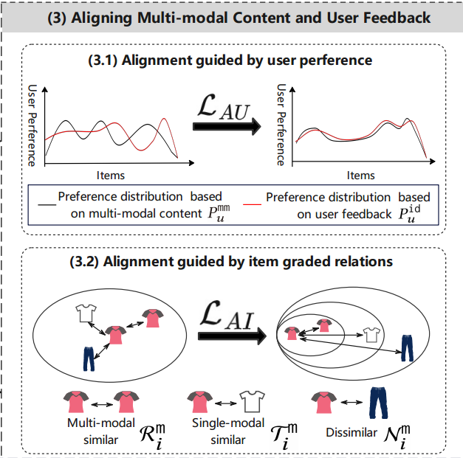




ChongqingUniversity of Technology
ATAI
AdvancedTechniqueof
Artificial Intelligence
ATAI
ChongqingUniversity _{AdvancedTechniqueof}
of Technology Artificial Intelligence
Method

Slide 7

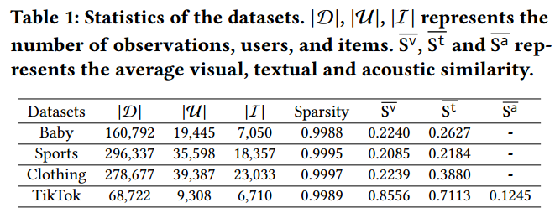
ATAI
AdvancedTechniqueof
Artificial Intelligence
ATAI
ChongqingUniversity _{AdvancedTechniqueof}
of Technology Artificial Intelligence
ChongqingUniversity of Technology
Experiments

Slide 8
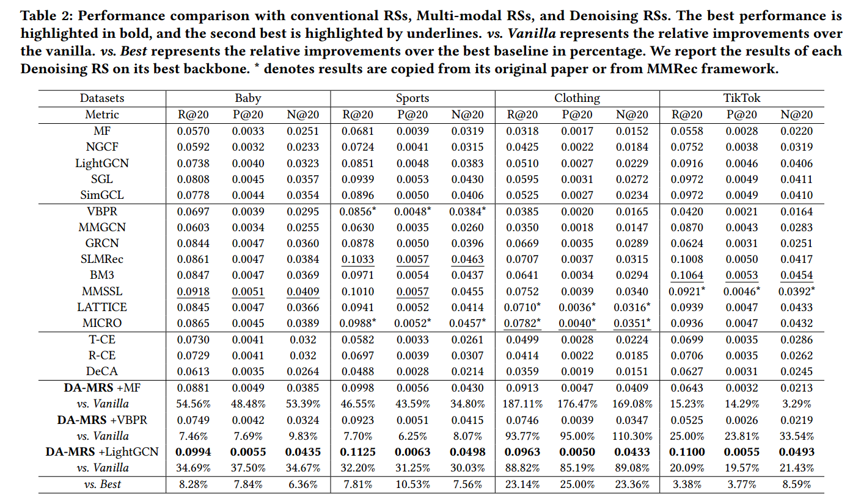
ATAI
AdvancedTechniqueof
Artificial Intelligence
ATAI
ChongqingUniversity _{AdvancedTechniqueof}
of Technology Artificial Intelligence
ChongqingUniversity of Technology
Experiments

Slide 9
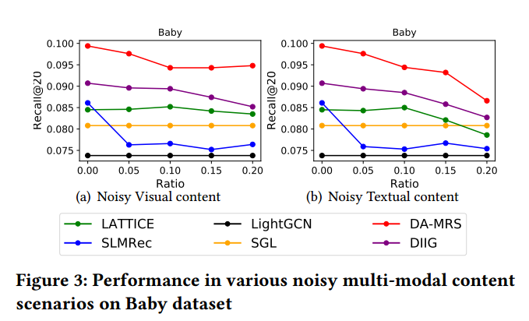
ATAI
AdvancedTechniqueof
Artificial Intelligence
ATAI
ChongqingUniversity _{AdvancedTechniqueof}
of Technology Artificial Intelligence
ChongqingUniversity of Technology
Experiments

Slide 10
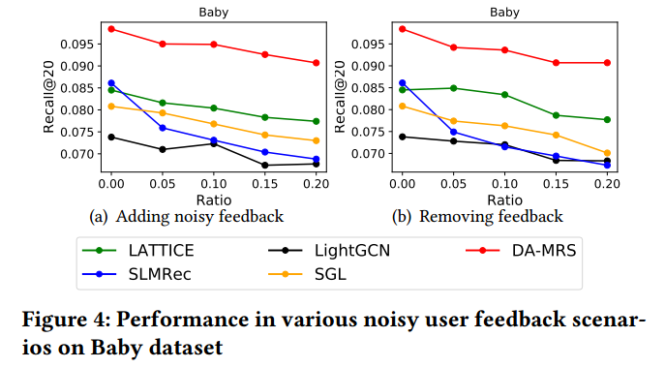
ATAI
AdvancedTechniqueof
Artificial Intelligence
ATAI
ChongqingUniversity _{AdvancedTechniqueof}
of Technology Artificial Intelligence
ChongqingUniversity of Technology
Experiments

Slide 11
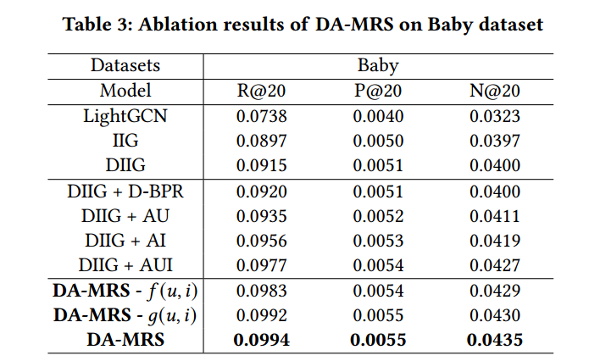
ATAI
AdvancedTechniqueof
Artificial Intelligence
ATAI
ChongqingUniversity _{AdvancedTechniqueof}
of Technology Artificial Intelligence
ChongqingUniversity of Technology
Experiments

Slide 12
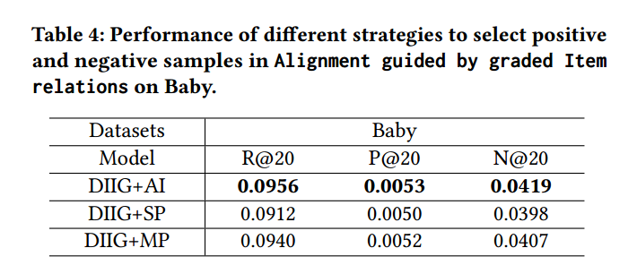
ATAI
AdvancedTechniqueof
Artificial Intelligence
ATAI
ChongqingUniversity _{AdvancedTechniqueof}
of Technology Artificial Intelligence
ChongqingUniversity of Technology
Experiments

Slide 13


ChongqingUniversity of Technology
ATAI
AdvancedTechniqueof
Artificial Intelligence
ATAI
ChongqingUniversity _{AdvancedTechniqueof}
of Technology Artificial Intelligence
Thanks!

